Slide 1
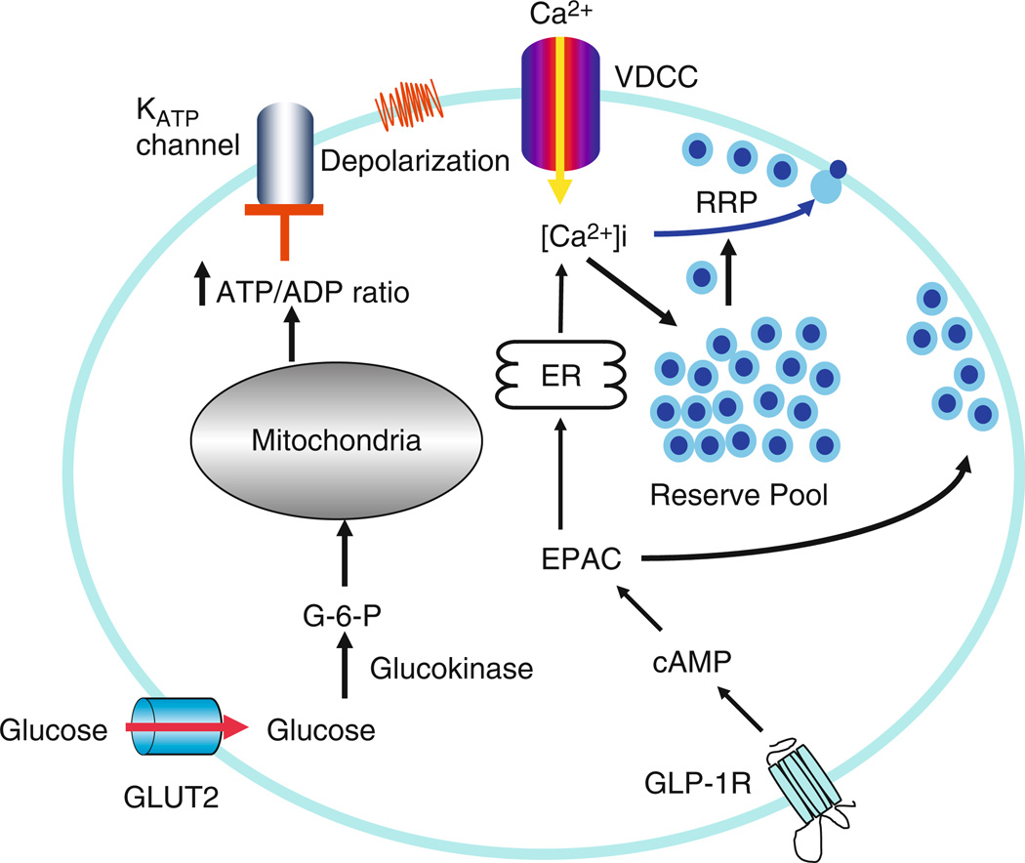
Intracellular Ca²⁺ is involved in Insulin Granule Exocytosis
ATP-sensitive K⁺ channels open and depolarize the cell in response to glucose metabolism
Voltage-gated Ca²⁺ open and increase in [Ca²⁺] triggers insulin granule exocytosis
Gap junctions allow communication of glucose stimuli to neighboring beta cells
Insulin Granule Biogenesis, Trafficking, and Exocytosis. Vitam Horm 2009

Slide 2
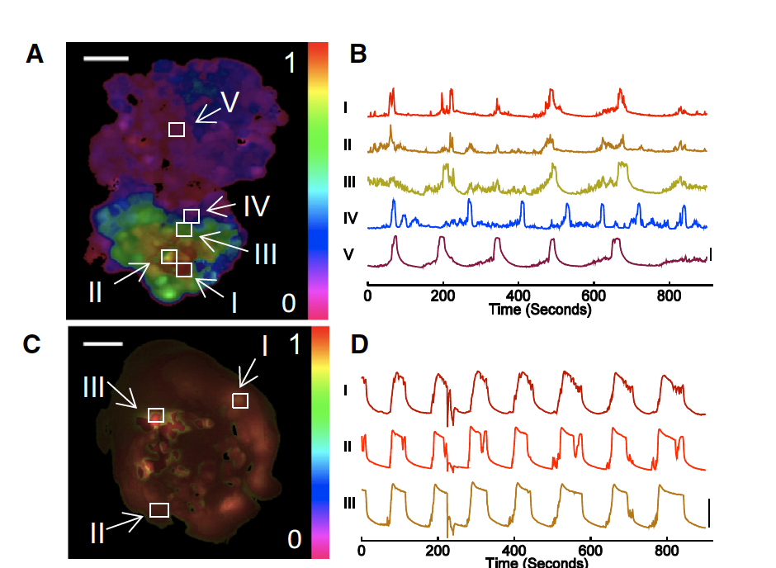
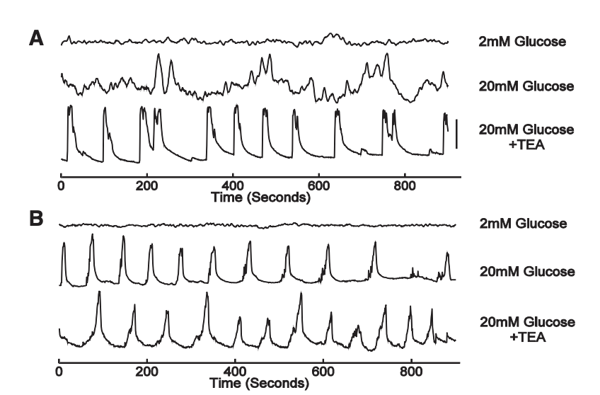
Synchronization of [Ca2+] oscillations is dependent on growth geometry
Ca2+ oscillations appear to be more tightly controlled in pseudo-islets relative to monolayers
MIN6 monolayers show reduced synchronization of [Ca2+] oscillations relative to pseudo-islets
50um
2D
[Ca2+]
Monolayer
3D
[Ca2+]
Pseudo-islet
Dimensionality and size scaling of coordinated Ca2+ dynamics in MIN6 beta-cell clusters. Biophysical Journal. 2014
Notes:
2

Slide 3
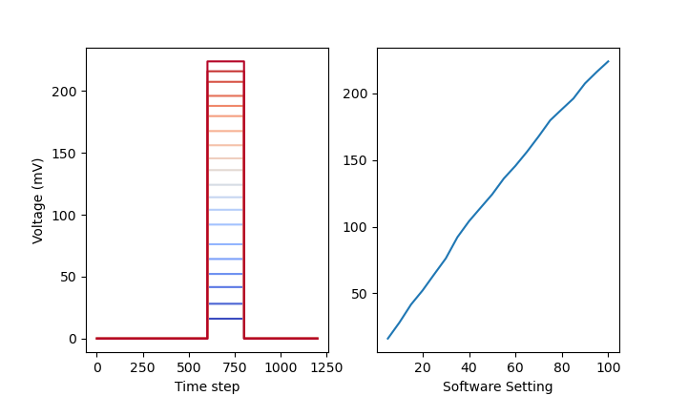

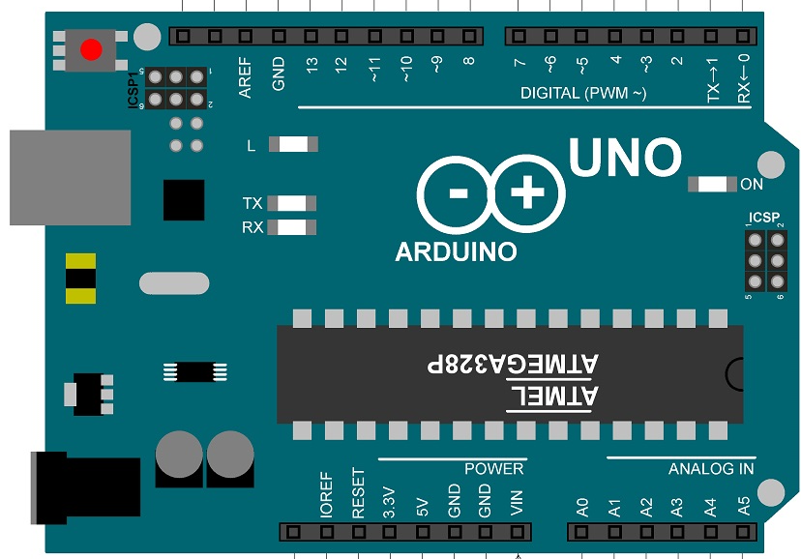
Photobleaching Imposes Constraints on Observable [Ca2+] Dynamics
PD
Fluorescent calcium indicators have a finite photon budget before photobleaching
High frame rates over short times or low frame rates over long times
High quantum efficiency and signal to noise ratio (SNR)
TTL - Transistor-Transistor Logic
PD - Photodiode
40X Water
LED
DM
UNO TTL
READOUT
Detector
M
CMOS TTL

Slide 4
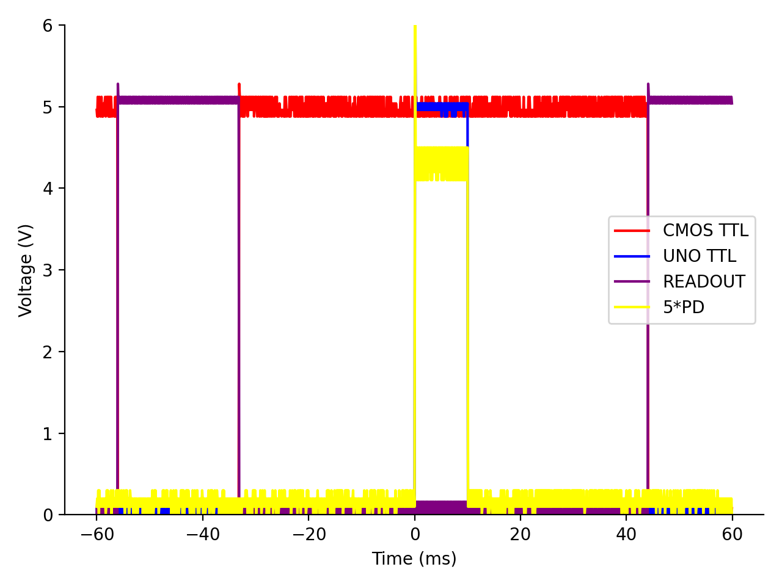
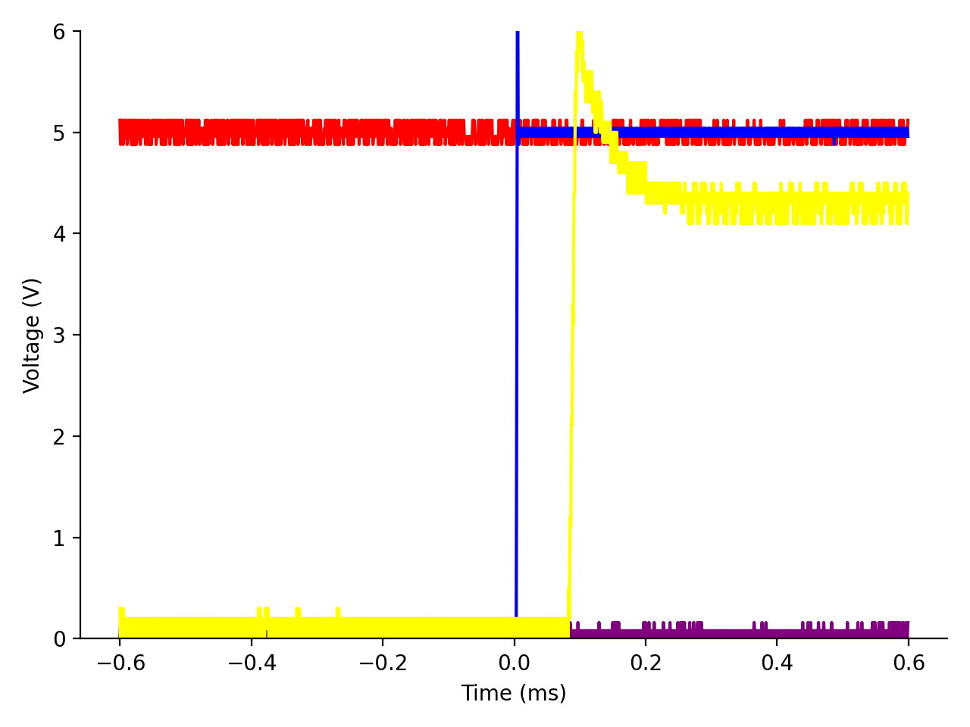
Transistor-Transistor Logic (TTL) Allows Precisely-Timed Pulsatile Excitation
Brief excitatory pulses during sensor exposure limits photobleaching at low frame rates
Global shuttering mechanism prevents collection bias over the CMOS sensor

Slide 5
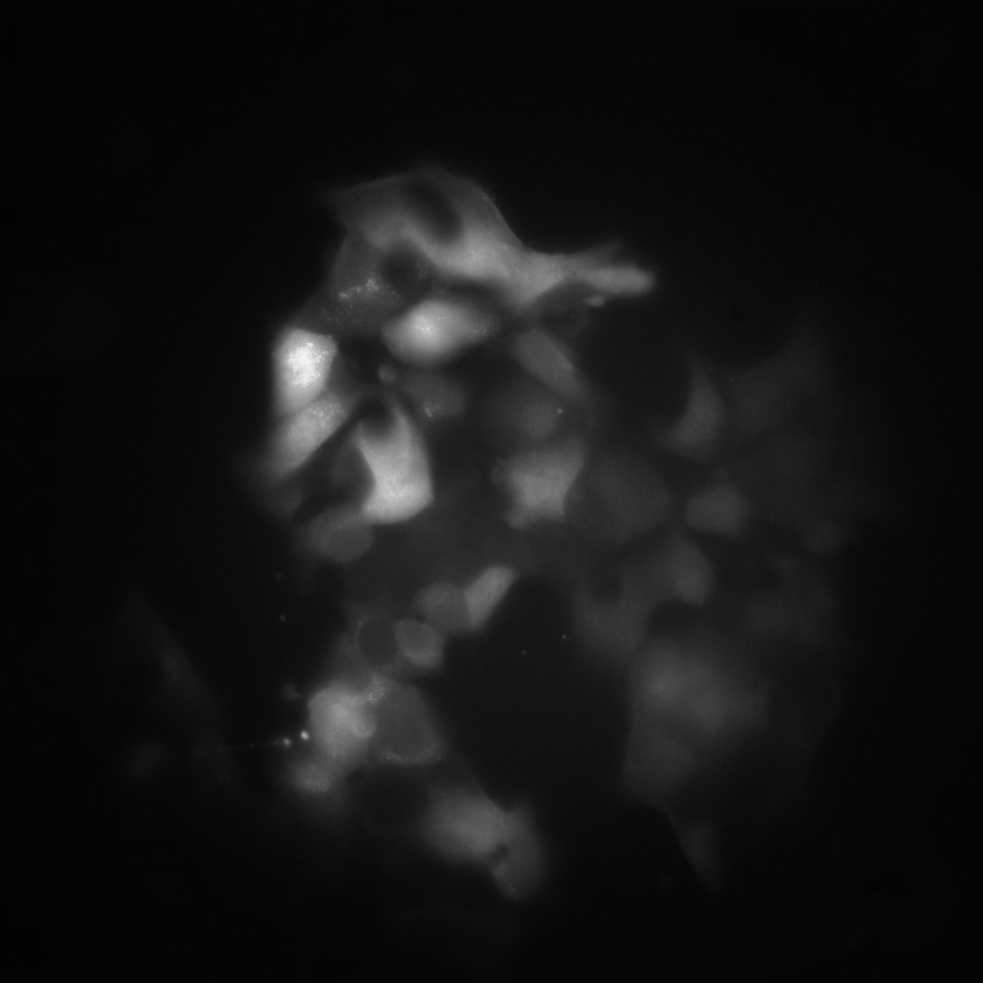
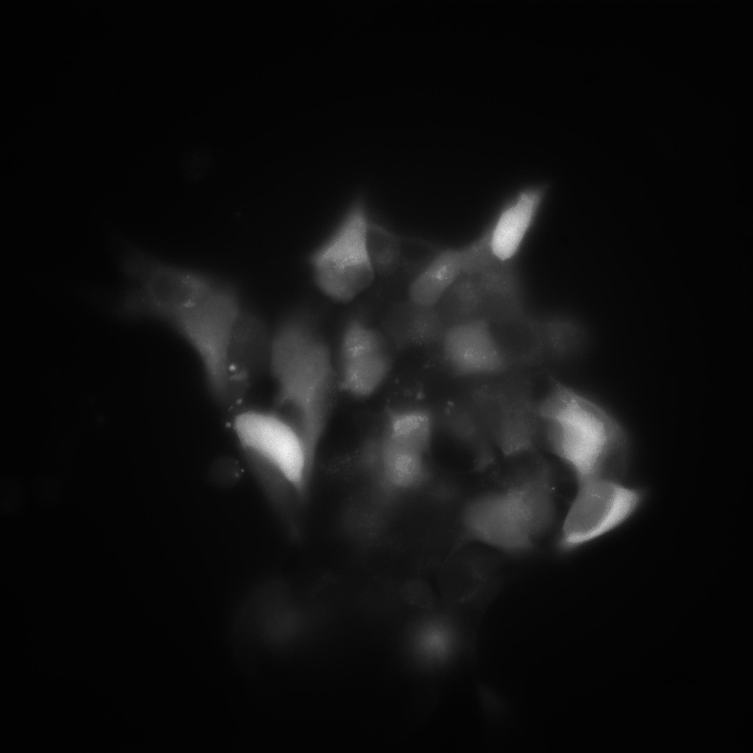
MIN6 Monolayers at 28mM (High) Glucose

Slide 6
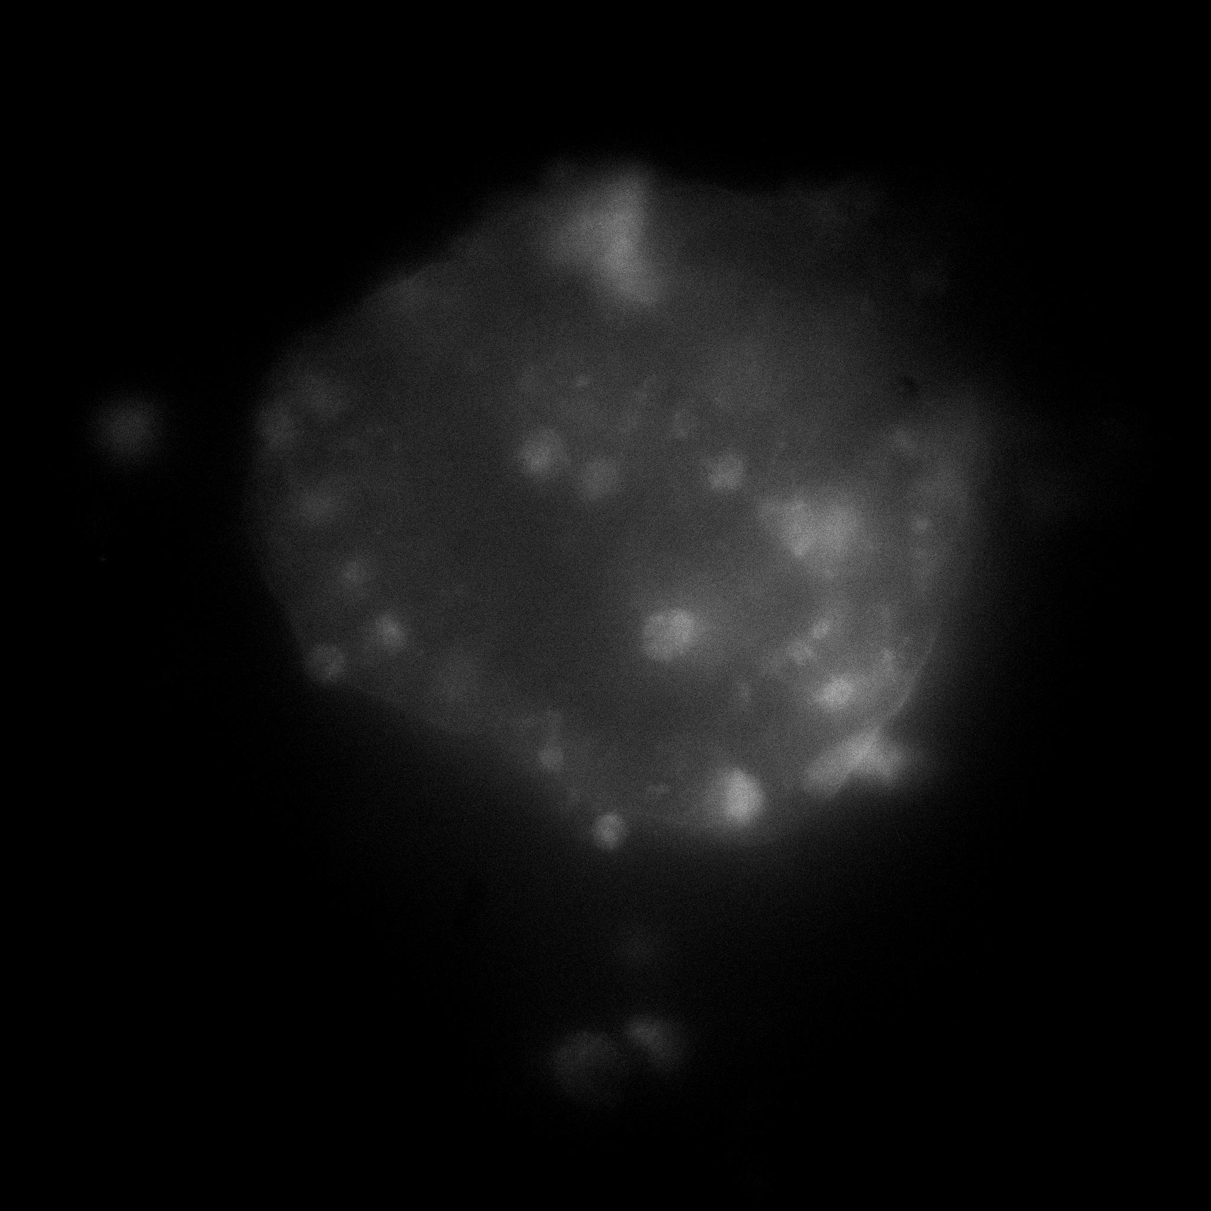
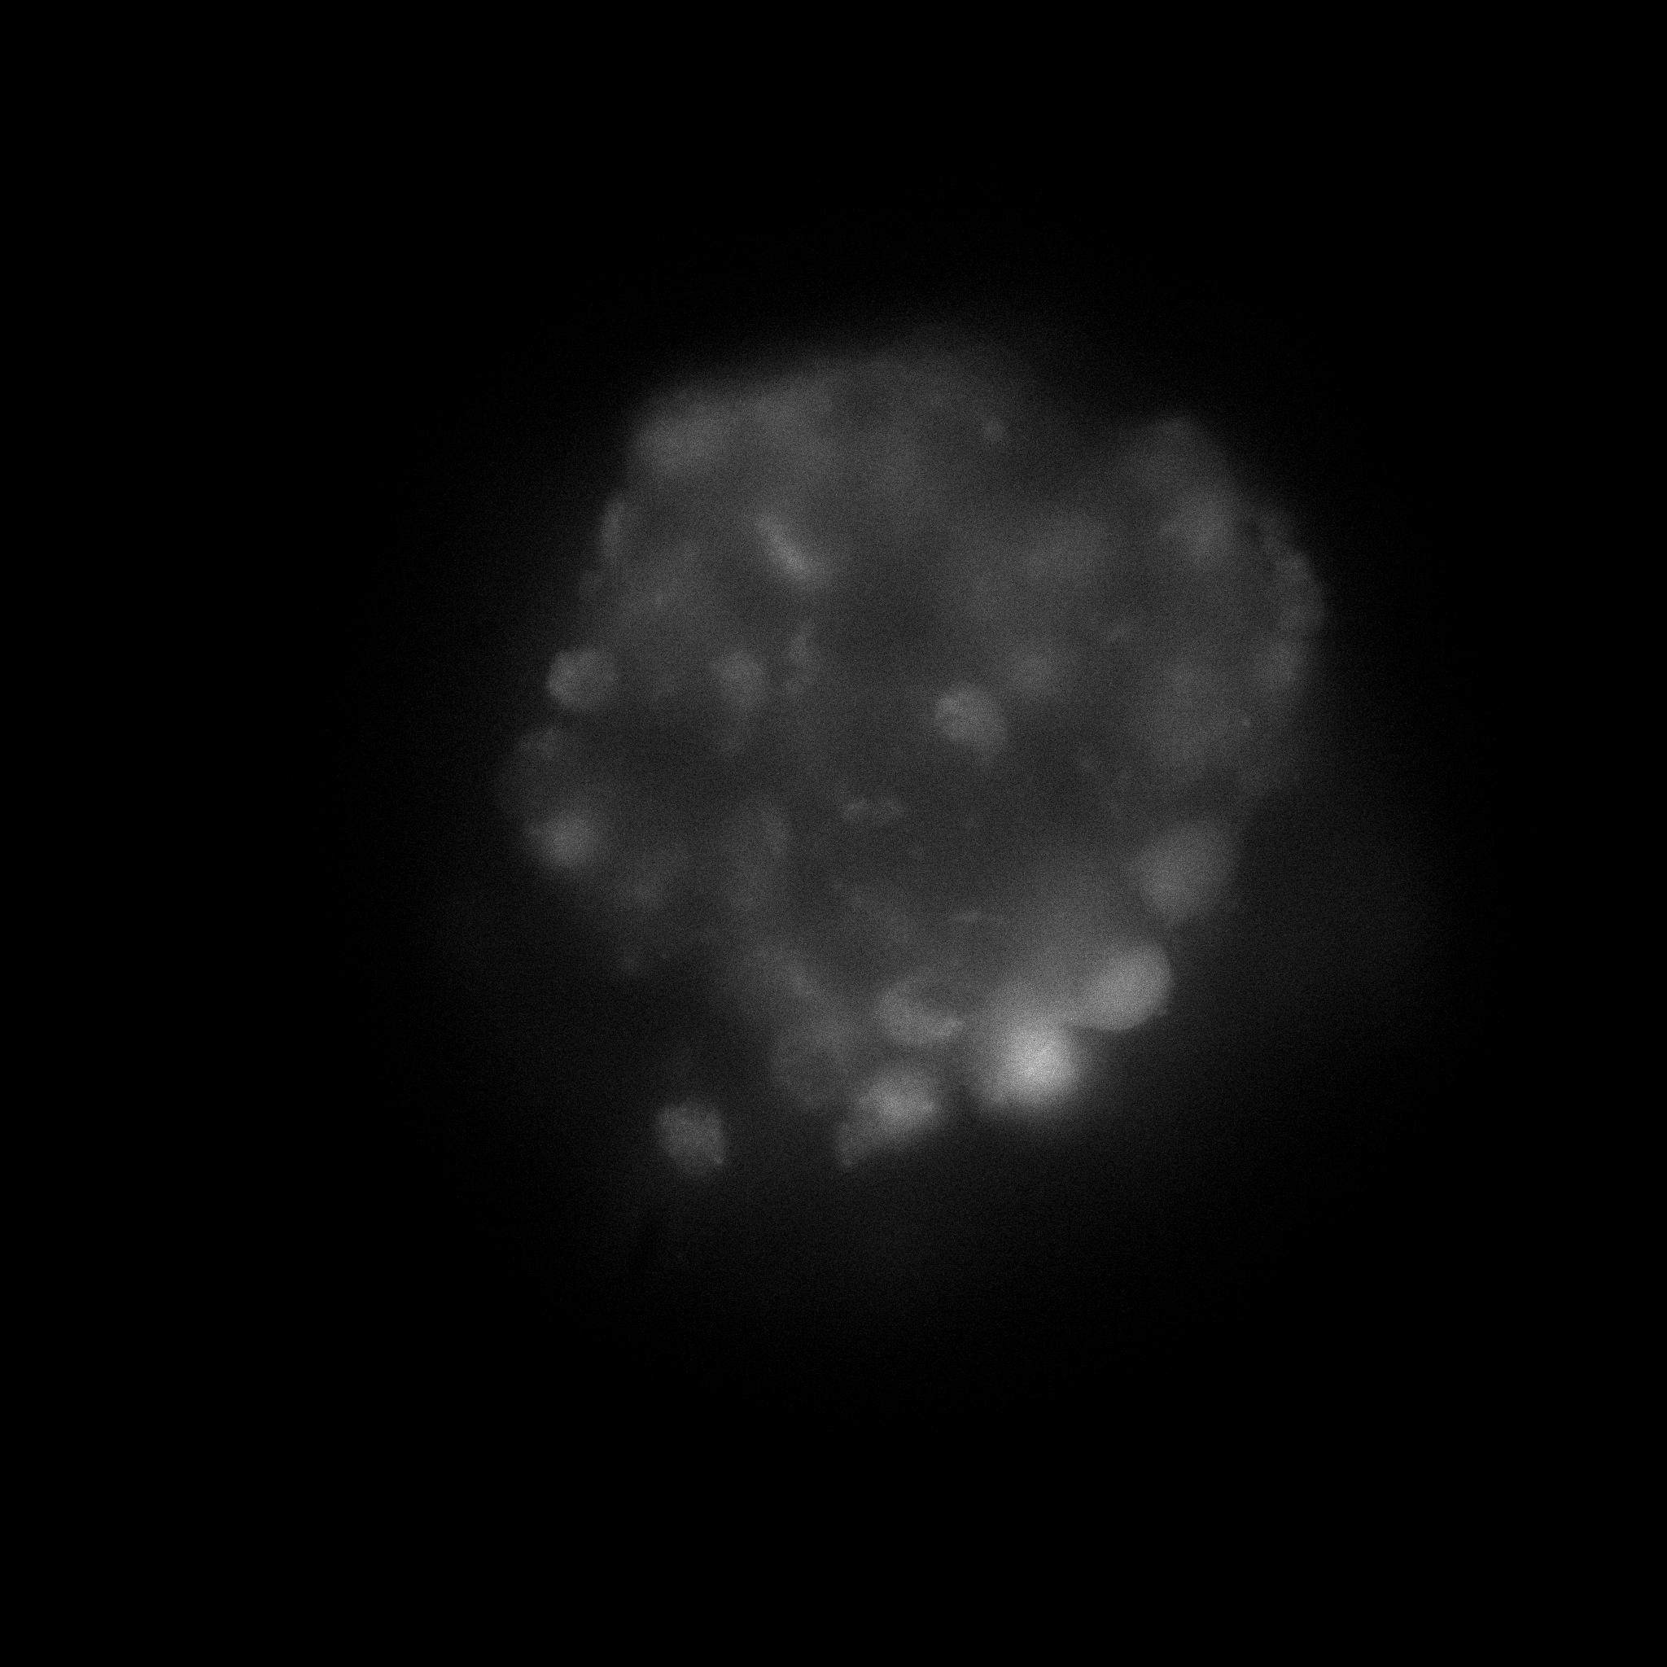
MIN6 Pseudo-Islets at 28mM (High) Glucose

Slide 7
Cell-Cell [Ca2+] Synchronization at 28mM Glucose

